Slide 1

CE101 Engineering Drawing Lec1: Introduction and Basics Part-1: Basics, Equipment, Lines and Lettering
Indian Institute of Technology Guwahati
Notes:
Today we will discuss about the Modeling and

Slide 2
Syllabus
Syllabus (2-0-3-7)
Importance of engineering drawing: dimensioning and scales
Conic sections and Curves
Orthographic projections: Points, lines, planes and solids
Sections of solids
Development of surfaces
Intersection of solids
Isometric projections
Introduction to Computer Aided Drafting

Slide 3
Books
Text/Reference Books
N. D. Bhatt and V. M. Panchal, Engineering Drawing Plane and Solid Geometry, 53rd Edition Charator Publishing House, 2014
K. Venugopal and V. Prabhu Raja, Engineering Drawing+ AutoCAD, 5th Edition, New Age International, 2011
D. A. Jolhe, Engineering Drawing with an Introduction to AutoCAD, McGraw Hill Education 2017
W. J. Luzadder and J. M. Duff, Fundamentals of Engineering Drawing, 11th Edition, PHI, 2012
F. E. Giesecke, A. Mitchell, H. C. Spencer, I. L. Hill, R. O. Loving, J. T. Dygdon and J. E. Novak, Engineering Drawing, 8th Edition, Person Prentice Hall, 2000

Slide 4
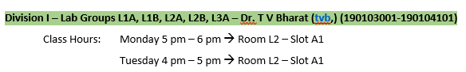
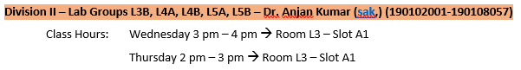
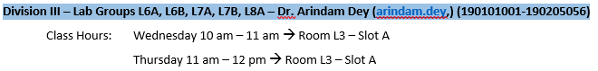
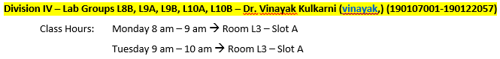
Know your Instructor / Lecture Classes

Slide 5
Know your Lab Class and Lab Instructor
Day | 9 AM - 12 PM |  | 2 PM - 5 PM
Monday | Lab 3A (Instructor - TVB) Prof. Subashisa Dutta (CE), subashisa, 1203 | Lab 3B (Instructor - AK) Mr. Bedabrata Ghose (CE) ghose176104009, 1204 | Lab 8A (Instructor - AD) Prof. Shyamanta M Hazarika (ME), s.m.hazarika, 1203 | Lab 8B (Instructor - VK) Dr. Nelson Muthu (ME) nelsonm, 1204
Tuesday | Lab 1A (Instructor - TVB) Dr. Sreeja P. (CE) sreeja, 1203 | Lab 1B (Instructor - TVB) Mr. Dhanesh Sing Das (CE) dhanesh, | Lab 6A (Instructor - AD) Dr. G Madhusudana (ME) gmadhu, 1203 | Lab 6B (Instructor - AD) Mr. Siddharth Garia (CE) sidd_41, 1204
Wednesday | Lab 4A (Instructor - AK) Dr. Akhilesh Maurya (CE) maurya, 1203 | Lab 4B (Instructor - AK) Mr. Nishant Bhargava (CE) n.bhargava, 1204 | Lab 9A (Instructor - VK) Prof. P. Muthukumar (ME) pmkumar, 1203 | Lab 9B (Instructor - VK) Dr. Bhaskar Kumar (ME) bhaskark, 1204
Thursday | Lab 2A (Instructor - TVB) Mr. Partha Das (CE) partha.das, 1203 | Lab 2B (Instructor - TVB) Prof. Baleshwar Singh (CE) baleshwar, 1204 | Lab 7A (Instructor - AD) Dr. Ajay Dashora (CE) abd, 1203 | Lab 7B (Instructor - AD) Ms. Priyanka Talukdar (CE) priyanka.talukdar, 1204
Friday | Lab 5A (Instructor - AK) Prof. C. Mallikarujuna (CE) c.mallikarjuna, 1203 | Lab 5B (Instructor - AK) Ms. Saswati Das (CE) saswati.das, 1204 | Lab 10A (Instructor - VK) Prof. Ajay Kalamdhad (CE) kajay, 1203 | Lab 10B (Instructor - VK) Dr. R Ganesh Narayan (ME) ganu, 1204

Slide 6
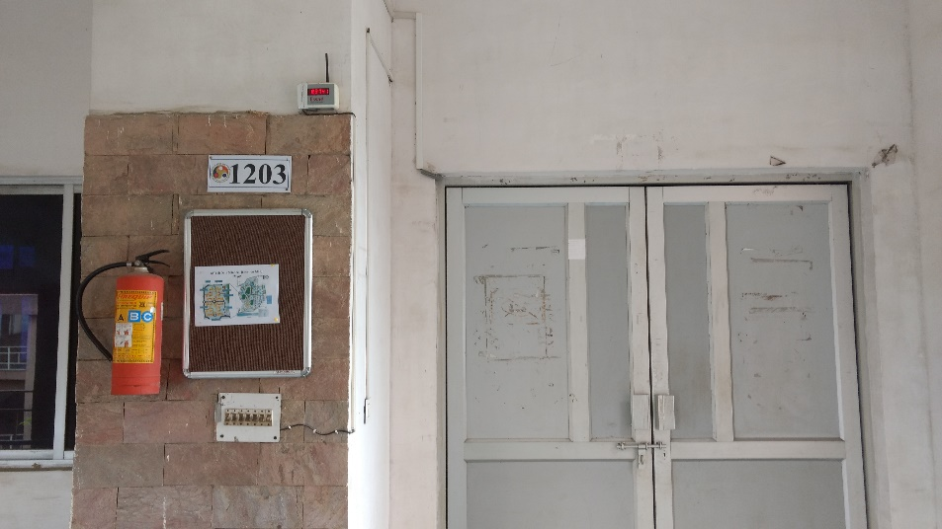
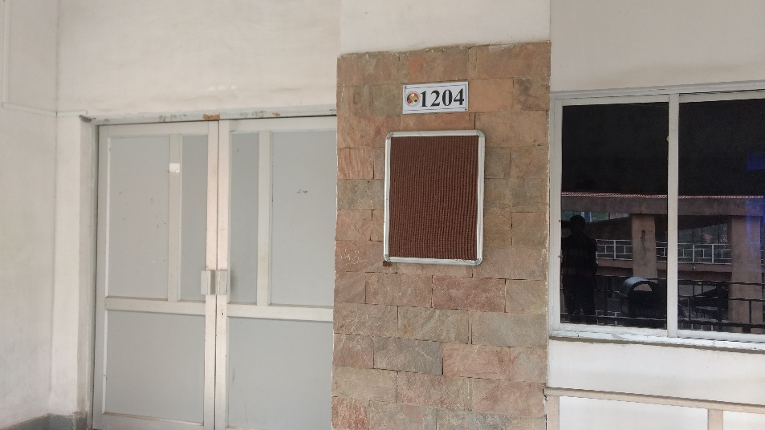
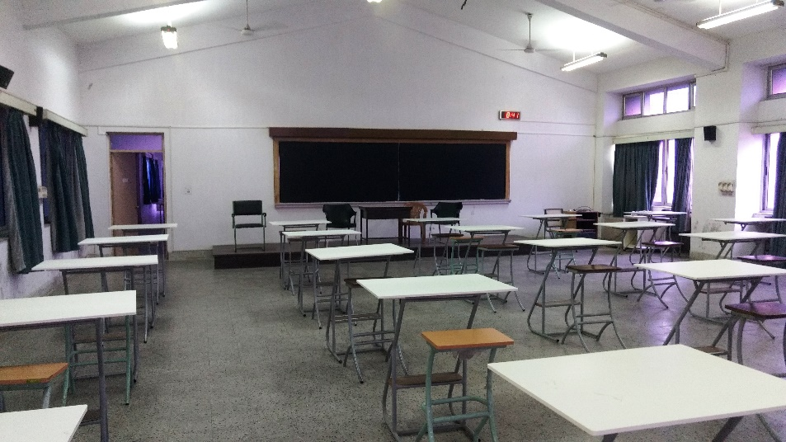
Know your Lab classrooms

Slide 7
Lab Sheets
10 lab sheets in total
Lettering and Scales
Curves and Conics
Orthographic Projections
Projections of points, lines and traces
Projections of planes
Projections of solids
Sections of solids
Development of surfaces
Intersections of solids
Isometric projections
Introduction to CAD – Presentation and Demonstration (No Tutorial Lab)

Slide 8
Points to Remember
Distribution of marks
Lab sheets – 50%, Mid-sem – 20%, End-sem – 30%
All Lab sheets to be completed in the stipulated class hours
Books and lecture notes allowed during lab classes
Lecture notes will be uploaded in the MOODLE
Mid-semester exam (2 hr objective questions based exam)
Date: 14.09.2019 (Time will be intimated later)
Venue - L1, L2, L3, L4
Course content up to Lecture 5
End-semester exam (based on regular board drawings)
Date: 14.11.2019 - 20.11.2019
Venue: Respective lab classes and lab hours

Slide 9
Points to Remember
Attendance
Lecture class and Lab class attendance are mandatory (as per ordinance)
It is essential to appear in the end-semester exam. In case of medical reasons or unavoidable personal work/reasons, change in date/slot or re-exam may be conducted. Students are advised to be in communication with their respective Lab instructors on regular basis
Make-up lab class
Student is allowed for make up class IF AND ONLY IF regular lab class is missed for GENUINE MEDICAL REASON
A single make-up class will be adjusted in the penultimate week before the exam (See the Roster)
Contact your tutor for further information
No make-up class for the completion of the incomplete assignments

Slide 10
Points to Remember
Evaluation Scheme
Based on the consolidated marks for each group (Lab sheets + End-sem), a first-step normalization would be made considering the highest and lowest for the respective group students
The absolute mid-sem marks would be added to normalized marks
A second round of normalization would be done considering the total marks of all student
Based on the second-round normalized marks, grades would be awarded considering the mean and standard deviations.

Slide 11
What is Engineering Drawing?
Drawing is a graphic representation of:
a real thing
an idea
a proposed design for later manufacture or construction
A PICTURE IS WORTH THOUSAND WORDS
Graphic representation:
Artistic: to express aesthetic, philosophic or other abstract ideas
Technical: to represent the design of objects to be built or constructed

Slide 12
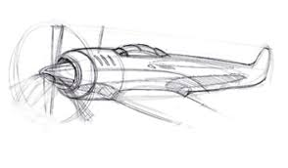
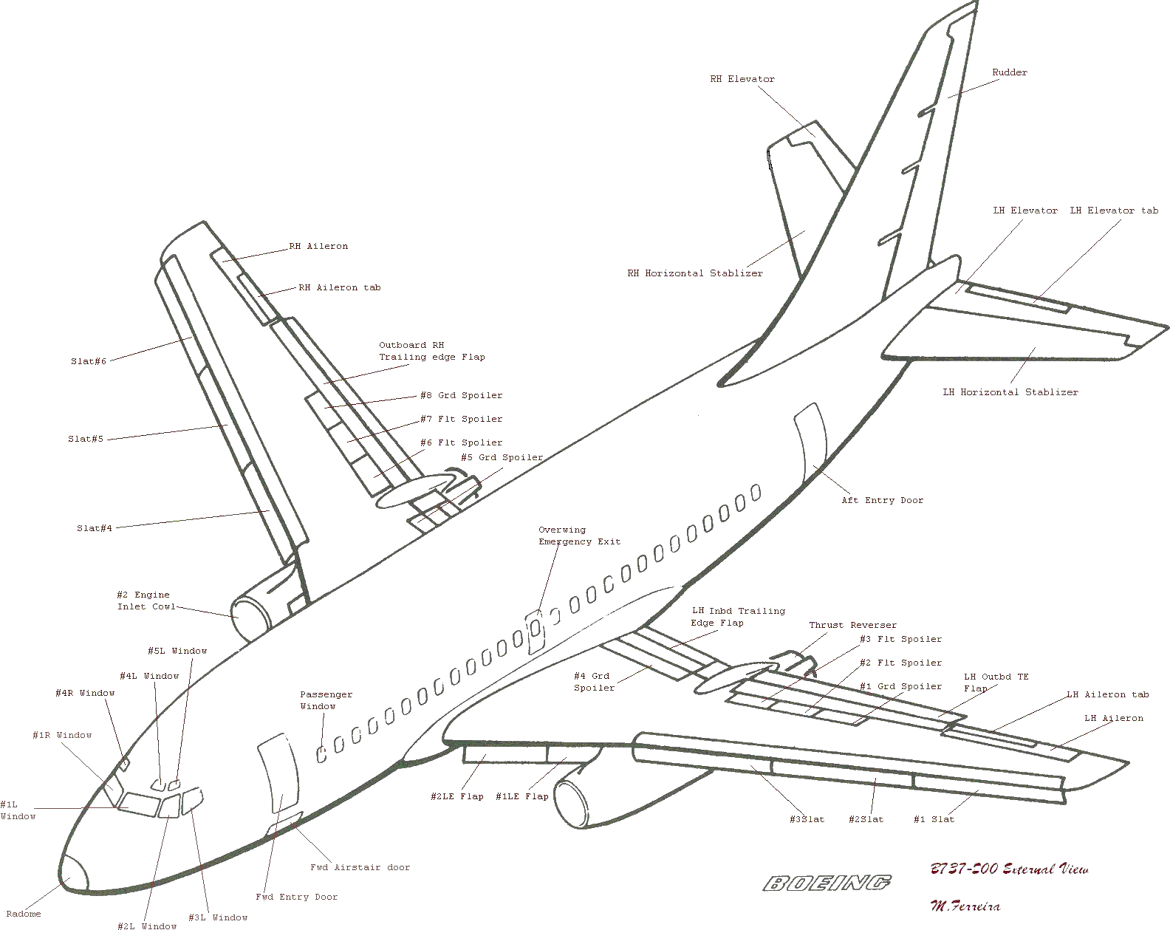


Slide 13

Why Drawing for Engineers?
To detail the maximum possible information than the normal vision
In the process of product development, two steps are involved:
Product specification
Product drawing
Irrespective of engineering discipline, any engineer should have a bare minimal understanding of engineering drawing
T
A simple example:
What do you see from different angles?
These are categorized as different views in engineering drawing. These are vital information when you consider “a product to be developed” in place of a dice
BS
RS
LS
T: Top view or plan; B: Bottom view
FS: Front side view or elevation
BS: Back side view
LS: Left side view; RS: Right side view
FS
B
All the views have to be successfully perceived and sketched before it can be developed, be it a nano, micro or macro product

Slide 14
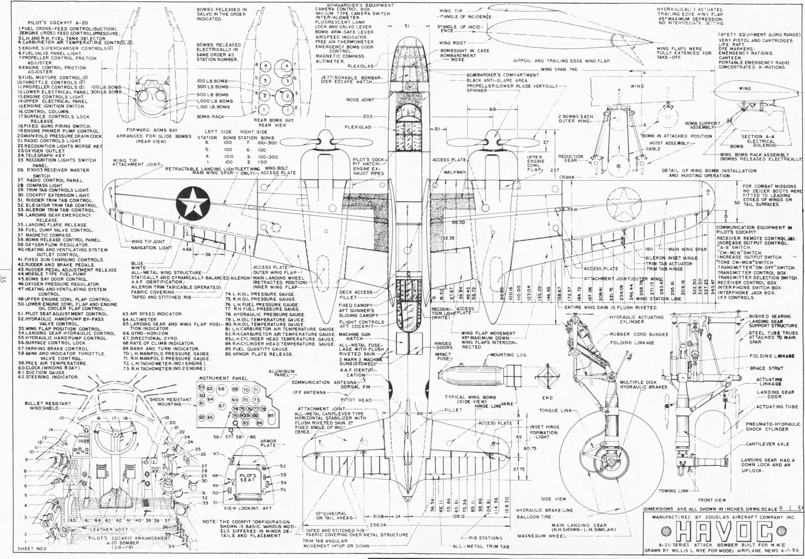

Slide 15
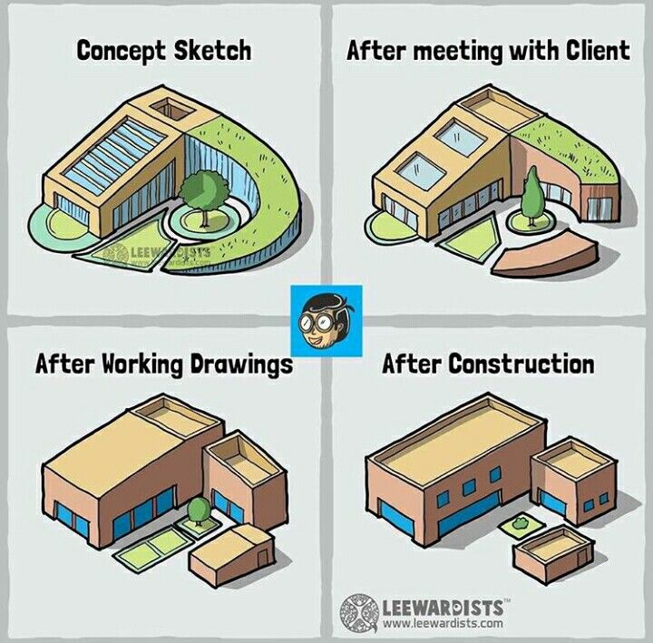

Slide 16
Objectives
To make and read correct graphics representations of engineering objects, structures and designs
To be able to execute the work with neatness, speed, and accuracy
To visualize the objects in three-dimension space

Slide 17
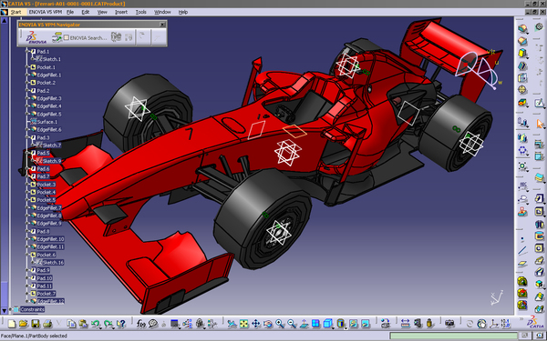
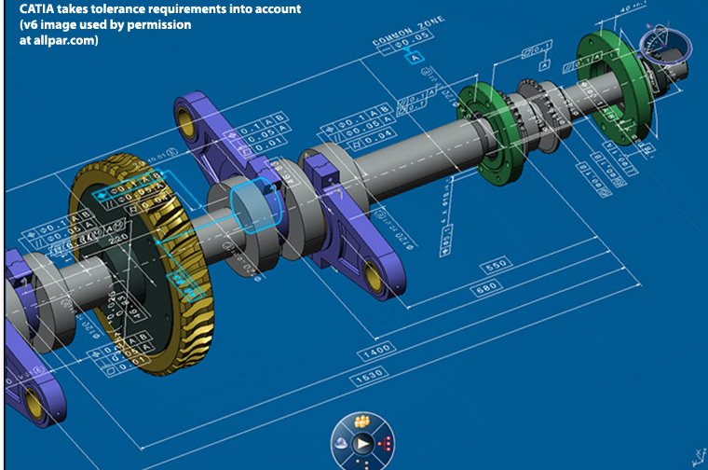

Slide 18


Slide 19
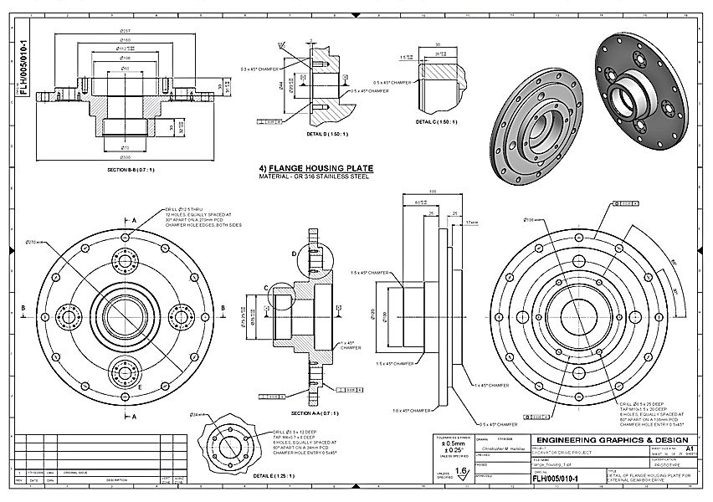
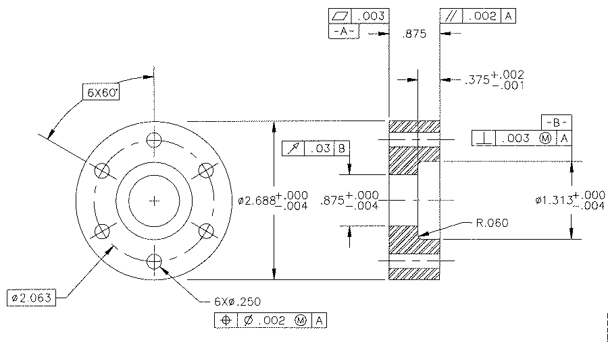

Slide 20
Lab Pre-requisites
Mini Drafter
Drawing sheet
Instrument box
compasses
dividers
Set-squares
eraser
French curves
Drawing clips, pins or adhesive tape
Pencils: Grades: H, 2H, HB and B
Pencil sharpener

Slide 21
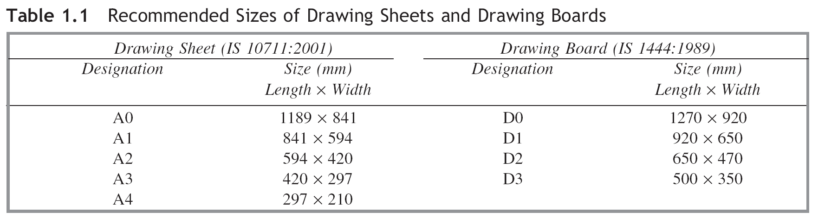
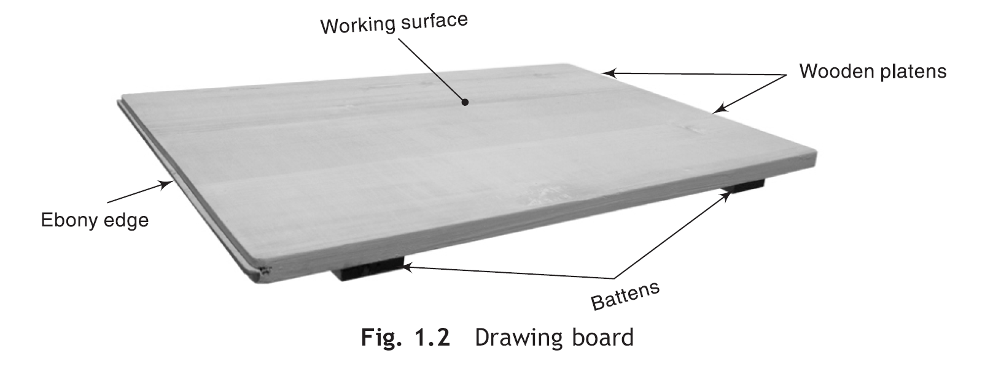
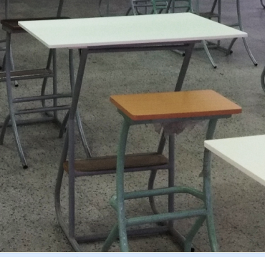
Prerequisite For Engineering Drawing

Slide 22
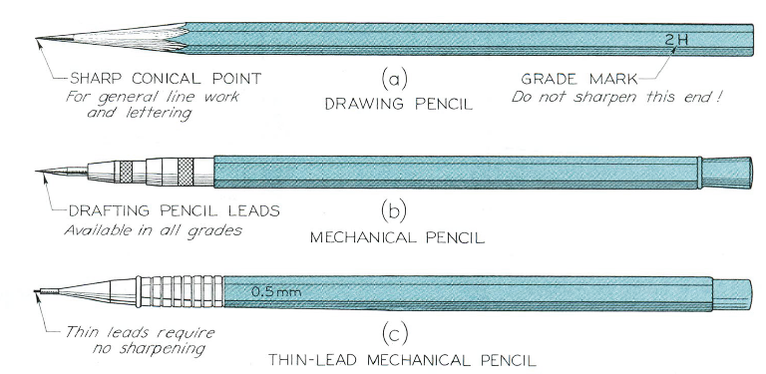
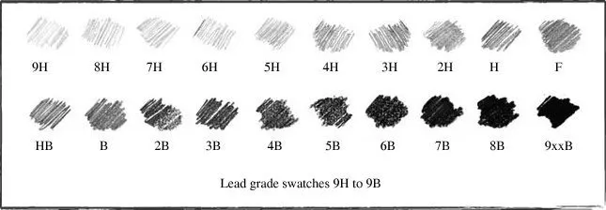
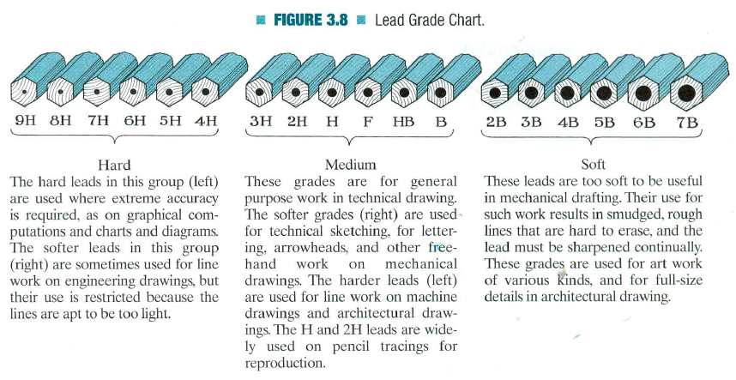
Prerequisite For Engineering Drawing
Lead Grade Sheet

Slide 23
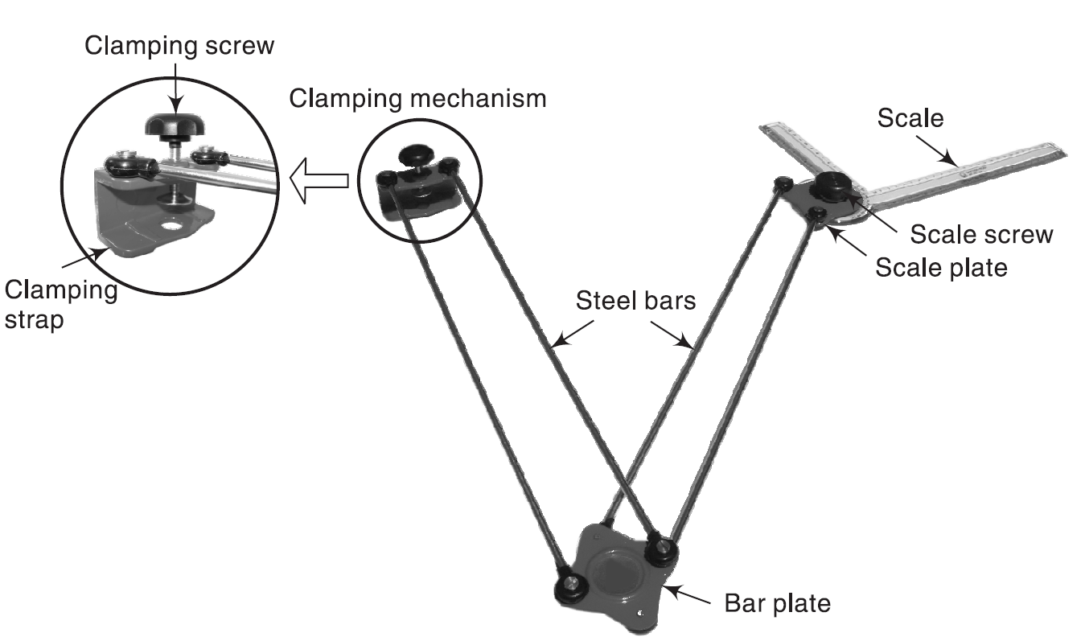
Prerequisite For Engineering Drawing

Slide 24
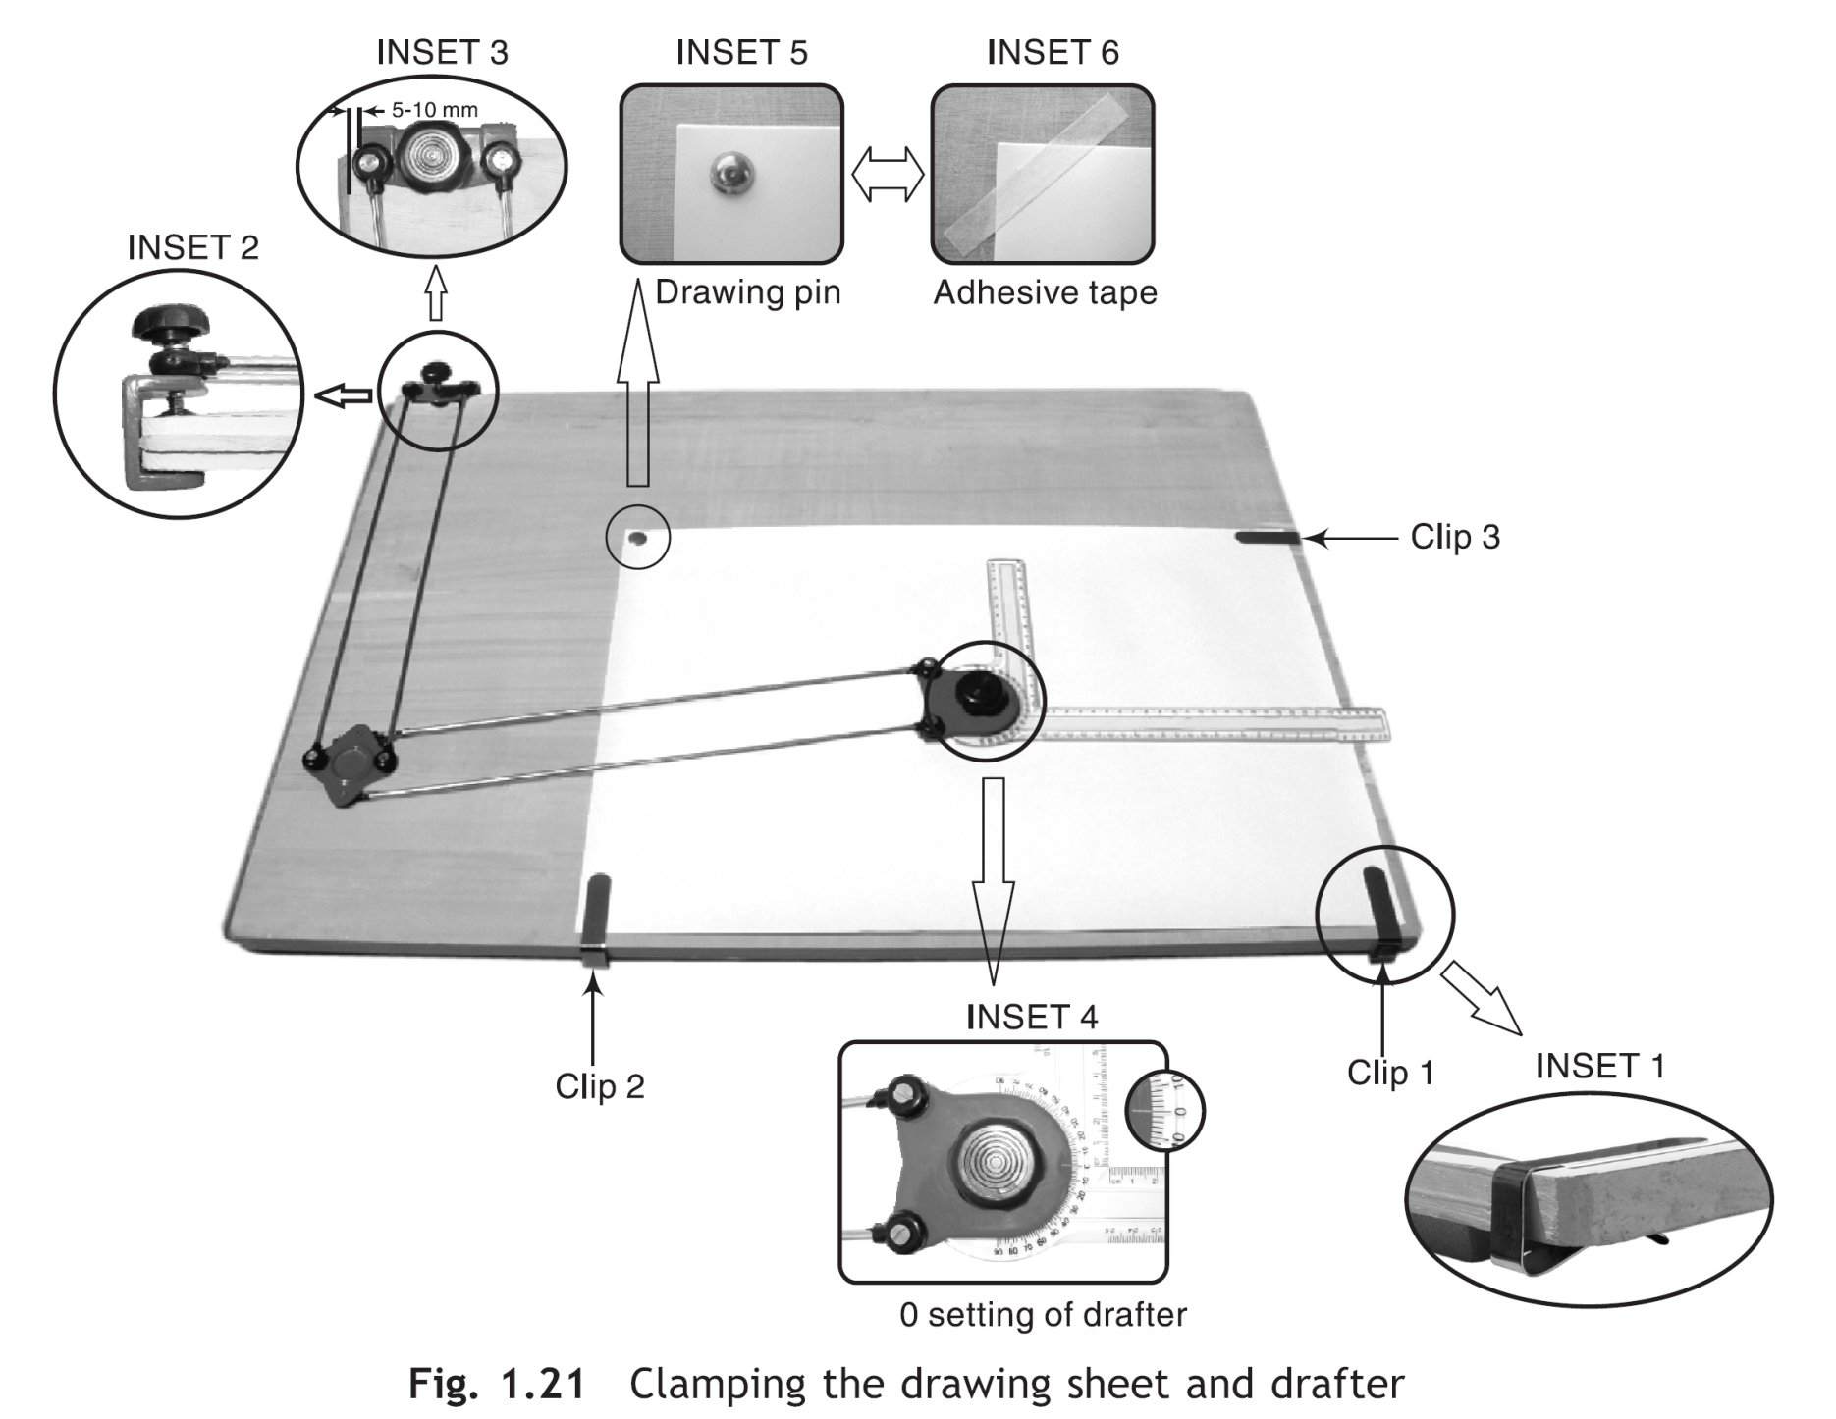
Prerequisite For Engineering Drawing

Slide 25
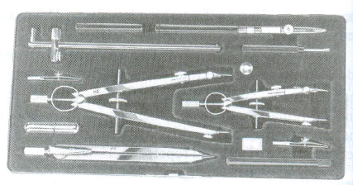
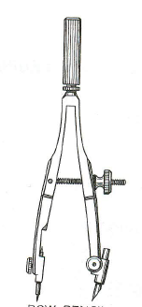
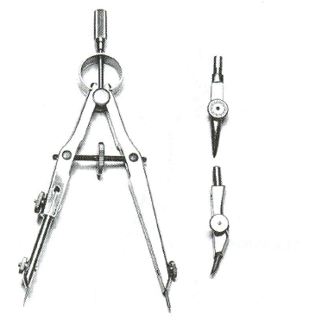
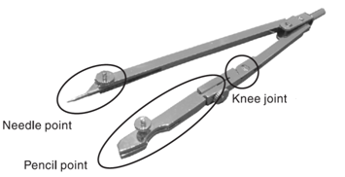
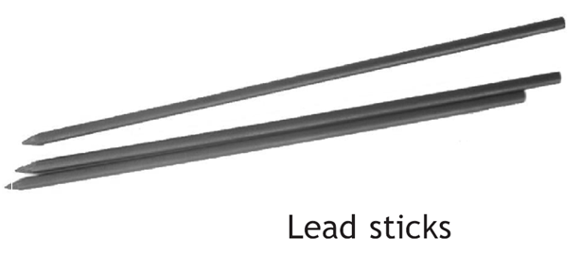
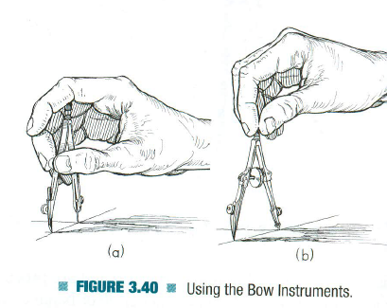
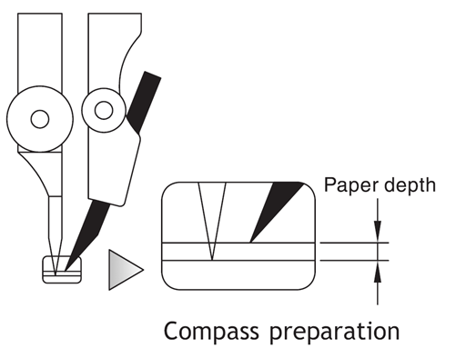
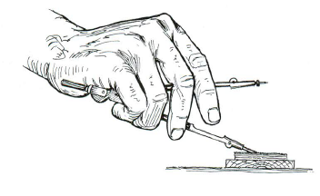

Slide 26
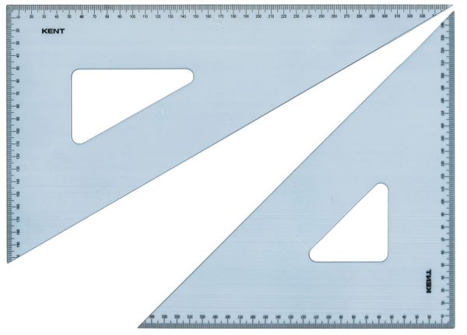
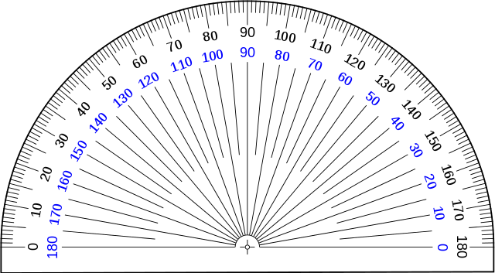
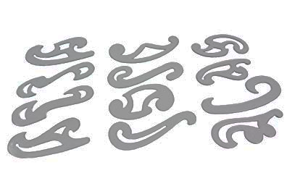

Slide 27
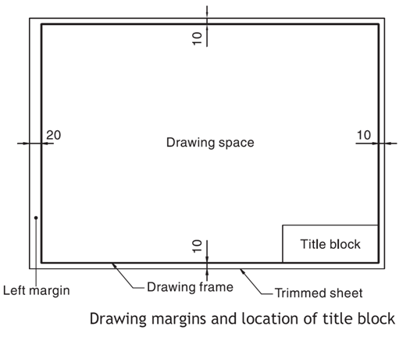
Prerequisite For Engineering Drawing

Slide 28
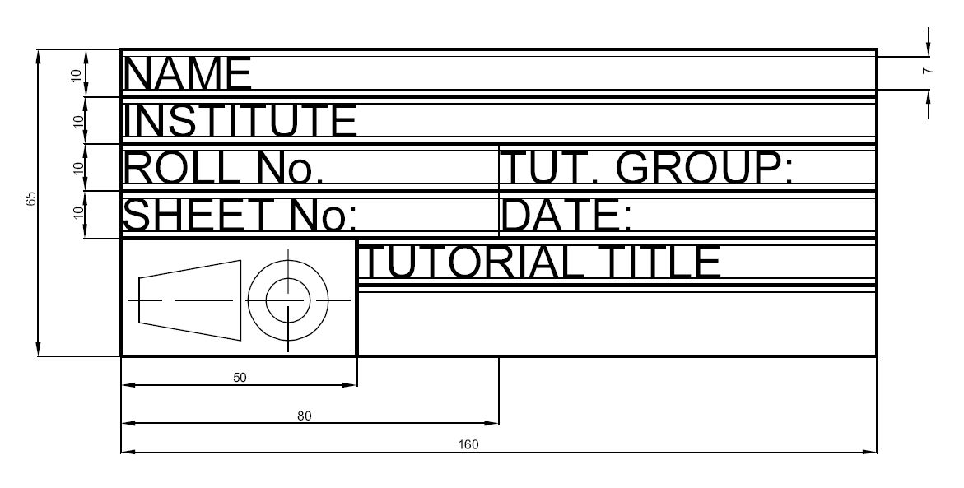
Prerequisite For Engineering Drawing

Slide 29
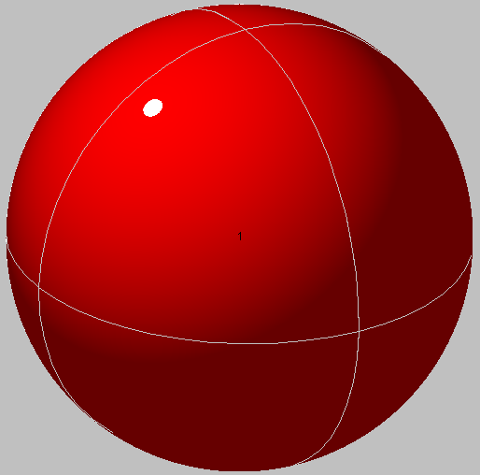
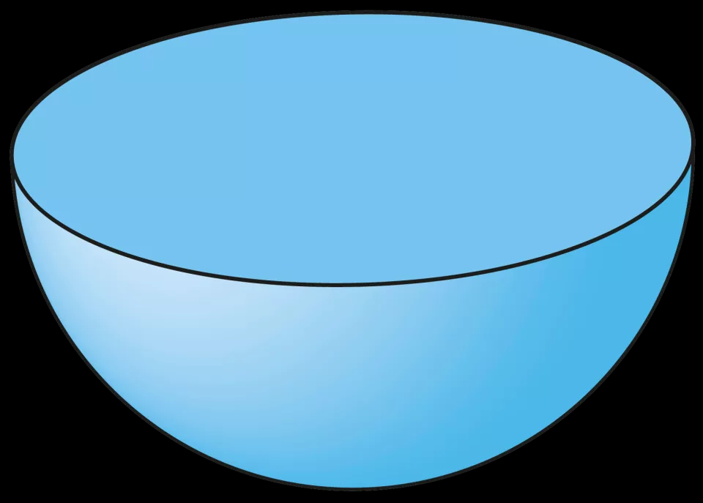
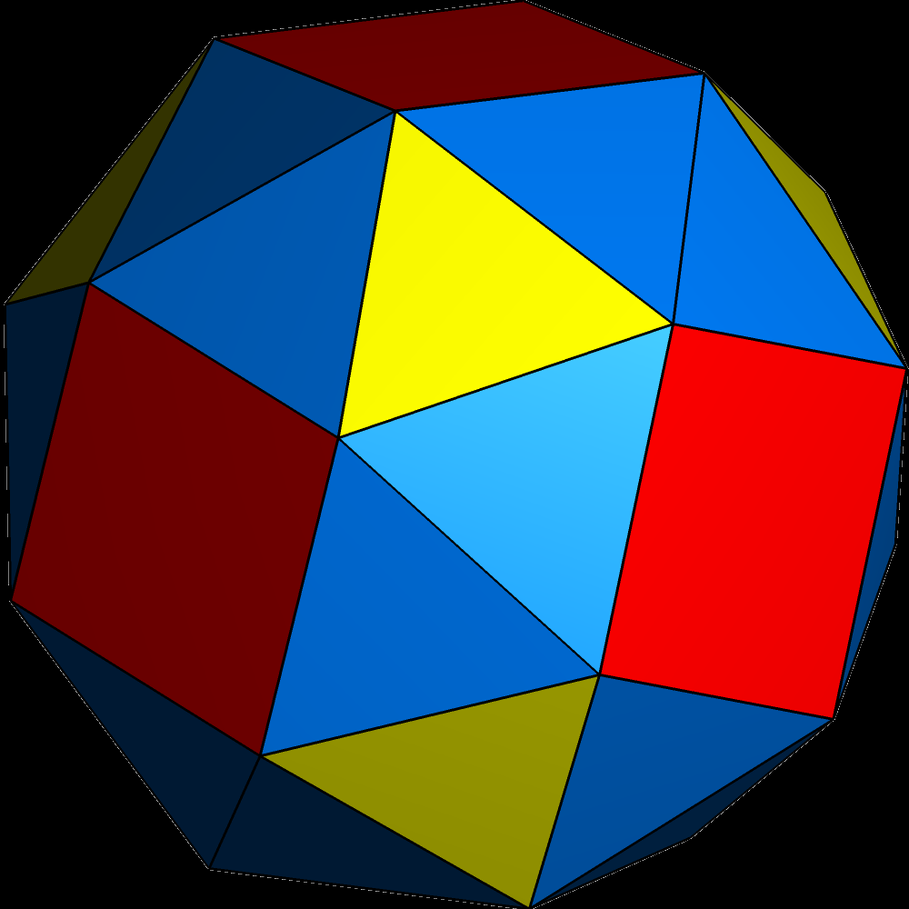
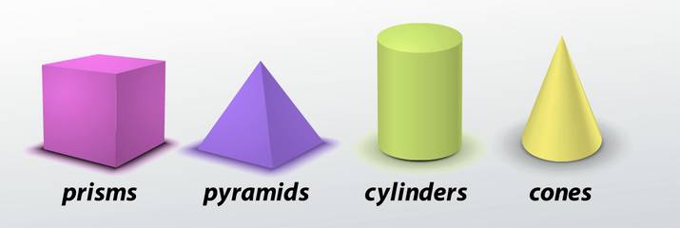
Graphic Language in
Engineering Drawing
“Engineering drawing” or “blueprint” uses lines to
represent the features of an object.
Features of an object are surface (include plane) and
edge.
Surface
Edge

Slide 32
Basic Strokes
Straight
Slanted
Horizontal
Curved
Examples
“I” letter
“A” letter
“B” letter
4
5
1
1
2
1
3
6
3
2

Slide 36
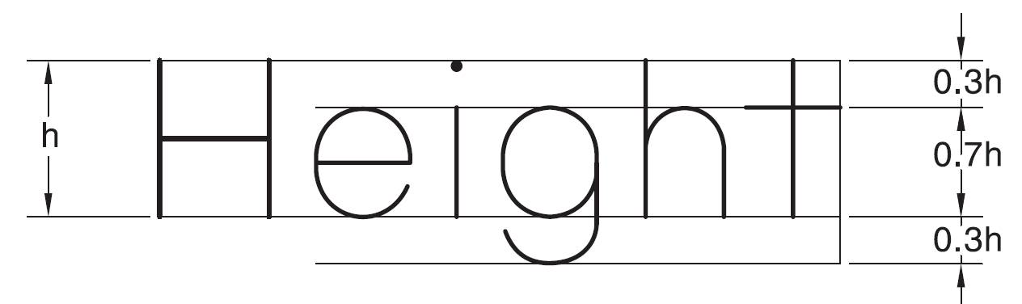
LETTERING
Single stroke: Thickness in single stroke lettering is obtained by a single stroke of pencil
The pencil or pen can be lifted while completing a particular letter
Double stroke: line width is greater than that of single stroke Lettering
Repetition of successive single strokes on the initial stroke
Height and Width of Letters
BIS (SP 46: 2003) has recommended the heights of letters as: 1.8 mm, 2.5 mm, 3.5 mm, 5 mm, 7 mm, 10 mm, 14 mm and 20 mm.
Large-sized letters are used for main titles and headings, medium-sized letters for subtitles and important notes and small-sized letters for dimensions and general notes.
The height of letters bears direct relationship with the size of drawing, i.e., large-sized letters for larger drawings and small-sized letters for smaller drawings.
The height-to-width ratio varies from letter to letter. Most of the letters follow the ratio 7 : 5 or 7 : 6.

Slide 37
Notes:
IMP : The line passing through the bottom of the capital letter is known as the base line.

Slide 39
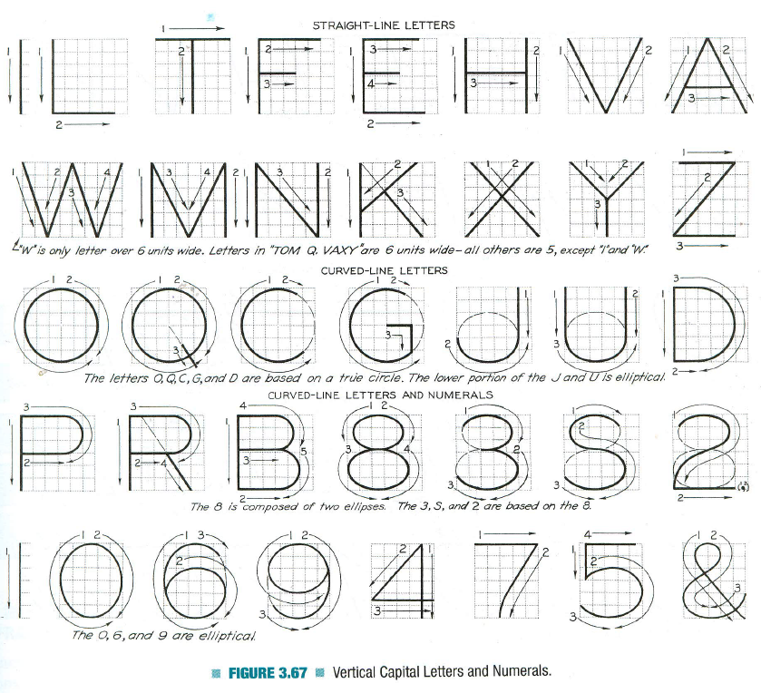
Vertical Capital Letters and Numeric

Slide 40
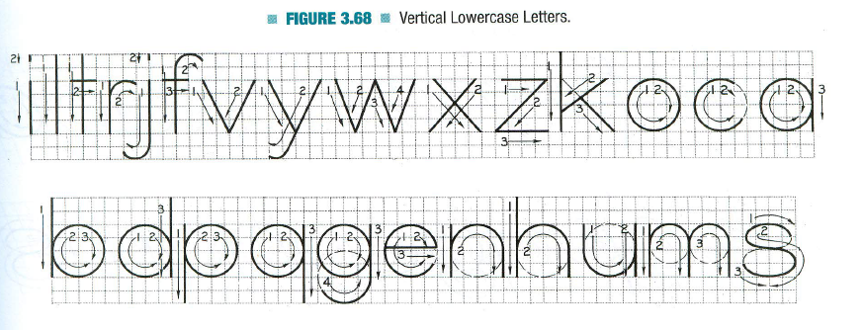
Vertical Lowercase Letters

Slide 41
Lettering Rules
Draw letters as simple as possible. Artistic or cursive lettering should be strictly avoided.
Draw letters symmetrical about the vertical axis or horizontal axis. Asymmetric letters like, F, R, Z, 4, etc., may be drawn as they are.
Round-off the sharp corners wherever necessary, e.g., D, P, S, etc.
Draw all letters legible and uniform.
The height of all the letters in one line should be the same.
Use single stroke vertical CAPITAL letters as much as possible.

Slide 42

Thank You for Patient Hearing

